Slide 1
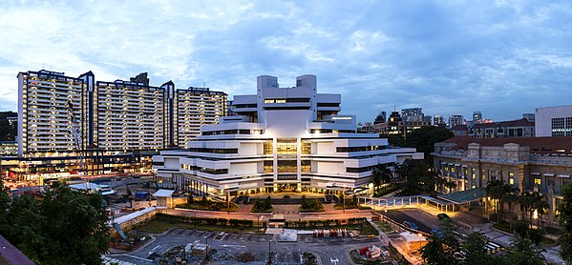
Data from the State Courts
Timothy Oen | Bryan Seah | Priscilla Pang |Trinisha Ann Sunil | Chelsea Chan |Cai Xiaohan

Slide 2

Objectives of Project
To determine the extent non-legal factors affect the:
Outcome of a case
Complexity of a case
Efficiency in Court Process
=
?

Slide 3
Data Source
Singapore District Courts (SGDC) and Singapore Magistrate’s Courts (SGMC) reported judgments on Lawnet
Time Period: 2011 – 2016
Civil Cases
Jurisdiction:
Civil actions < $250,000; road traffic or industrial accident claims < $500,000
Excluding Family Law cases
Excluding Criminal Law cases
Changes in State Court’s jurisdiction on 1 Jan 2011 and 1 Dec 2016
Reported judgments = only those appealed to High Court

Slide 4
Summary of X- and Y-Variables
Y-Variables
Number of Issues
Word Count
Duration of Litigation
Success of Plaintiff / Defendant
X-Variables
Type of claim
Coram
Coram’s Years in Office
Type of Plaintiff / Defendant
Lawyer’s Years in Practice
Law Firm’s Size

Slide 5
X-Variable: Type of Claim
Description: Type of claim, e.g. contract or tort
Qualitative (Nominal) Variable
Parameters
1 = Contract
2 = Tort
3 = Property/ Equity
4 = Civil Procedure
5 = Miscellaneous (Statutory)
6 = Miscellaneous (Non-Statutory)
7 = Multiple claims

Slide 6
X-Variable: Coram
Description: Name of Judge deciding case
Qualitative (Nominal) Variable
Expressed as a string (i.e. Coram’s name)

Slide 7
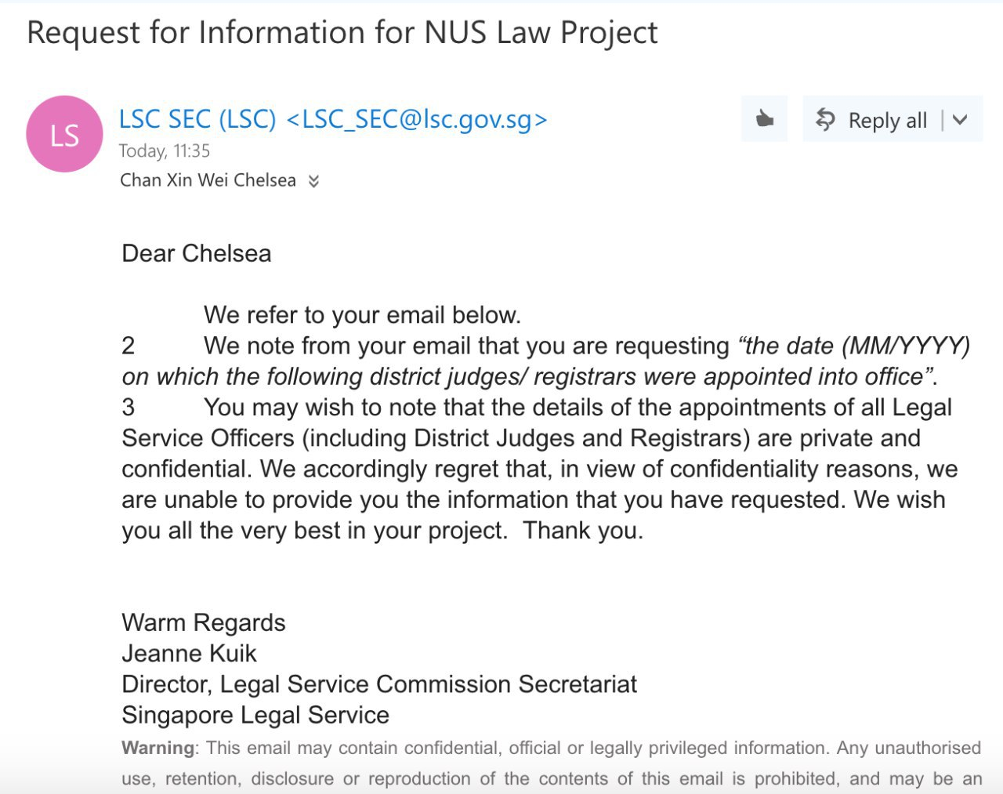
X-Variable: Coram’s Years in Office
Description: Number of years that Judge has been in office
Quantitative Variable, expressed in number of years.
Could not obtain information directly from Legal Service Commission
Solution: Used “earliest case decided by that judge on LawNet” as a proxy
Took the difference between “year of decision” and “year of first reported decision”

Slide 8
X-Variable: Type of Plaintiff/Defendant
Description: Profile of Pf and Df (e.g. individual or company)
Qualitative (Nominal) Variable
Parameters
0 = Company
1 = Individual / Sole Proprietor
2 = Miscellaneous (e.g. MCST; MAS; Associations)

Slide 9
X-Variable: Lawyer’s Year in Practice (PQE)
Description: Number of years Pf’s / Df’s lawyer has been in practice
Quantitative Variable, expressed in number of years.
Litigants-in-person = “-1”
Excluded LIPs from analysis because they cannot be compared to a lawyer
Took the difference between the year of decision and the year the lawyer was admitted to the Singapore Bar

Slide 10
X-Variable: Lawyer’s Year in Practice (PQE)
Problem: Missing and unavailable data
Data on “date of admission to the Bar” was taken from the Law Society’s list of members eligible to vote in the 2017 Law Society elections
Hence there was missing data for lawyers no longer on the rolls (e.g. no longer practising or struck off)
Solution: Excluded missing data points
Limitations of Data Set:
all lawyers had PQE above 10
Only took into account first chairs of the representing lawyers

Slide 11
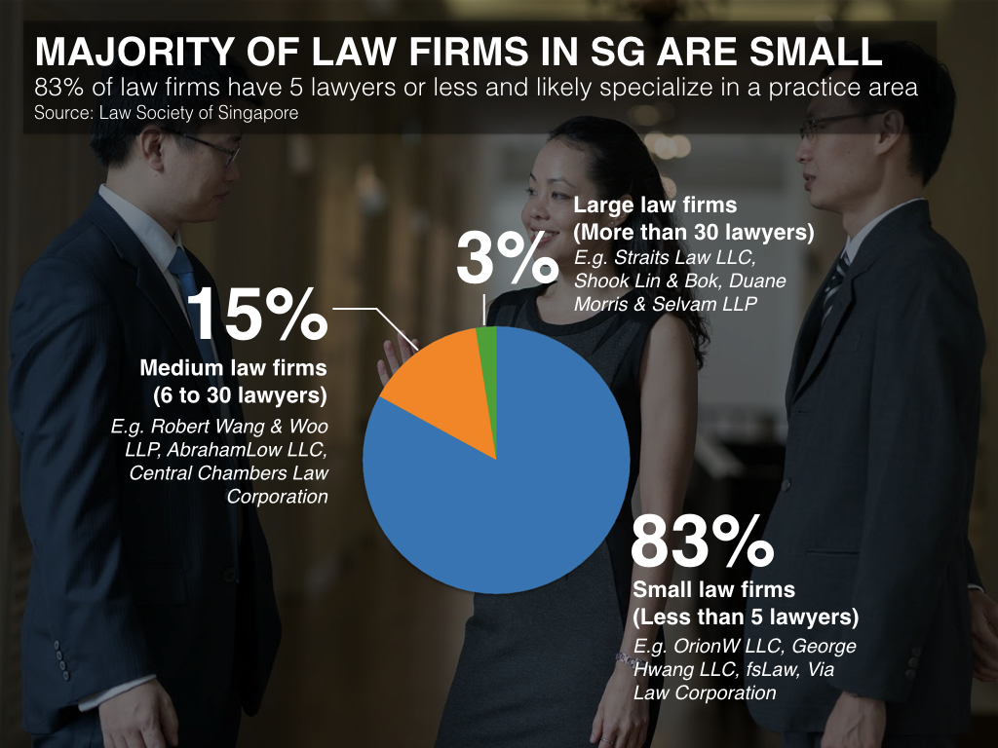
X-Variable: Law Firm Size
Description: Size of law firm representing Pf / Df
Qualitative Variable (Nominal)
Parameters:
0 = Litigants-in-person
1 = Small firm (1 - 5 lawyers)
2 = Mid-sized firm (6 - 30 lawyers)
3 = Large firm (>30 lawyers)
Problem: This categorization (of small/ medium/ large) was skewed
However, there was no other way to get information on a law firm’s size except through the MinLaw website, which only reflected the “small/ medium/ large” categorization

Slide 12
Y-Variable: Number of Issues
Description: Number of issues raised in case
Quantitative Variable
Problem: Difficulty with standardizing the methodology of counting issues
(1) Judges do not explicitly state the issues in the case, or inconsistent in how they frame the issues
(2) Overlap between “factual” and “legal” issues
(3) Number of issues =/= number of claims. E.g. Talent Capital Resources Pte Ltd v Heng Aik Swan and another [2013] SGDC 146 had three different claims (contract, conversion and company law) but Judge decided on only one threshold factual issue (Pf did not own the chattel).

Slide 13
Y-Variable: Word Count
Description: Number of words in judgment
Quantitative Variable
Using the NLTK package, coded a .py script that will count the words in a judgment
Script ignored numbers, punctuation, and NLTK’s list of stop words
Advantage of using ‘Stripped’ word count
Removing words void of useful information makes the ‘stripped’ word count a better gauge of the complexity of the case

Slide 14
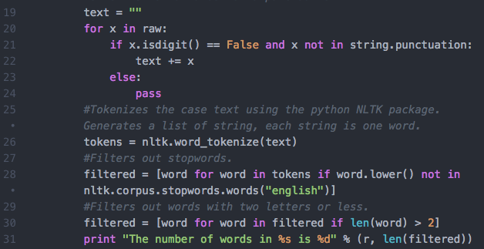
Y-Variable: Word Count (Script)

Slide 15
Y-Variable: Word Count (Filter Demo)
1 In this action, the plaintiff sued the defendant for repayment of $188,000.00, which was the balance amount of a loan. I found for the plaintiff. 2 The defendant has appealed my decision. I now set out my reasons. 3 The plaintiff was a fire fighter-cum-paramedic employed by the Singapore Civil Defence Force. In 2002, he suffered serious injuries in a road traffic accident which occurred in the course of his employment.
Word Count: 72
action plaintiff sued defendant repayment balance amount loan found plaintiff defendant appealed decision set reasons plaintiff fire fightercumparamedic employed Singapore Civil Defence Force suffered serious injuries road traffic accident occurred course employment
Word Count: 32

Slide 16
Y-Variable: Duration of Litigation
Description: Number of years taken for litigation to reach decision
Quantitative Variable
Measured in years, by taking the difference between the year of the decision and the year that the O.S. was filed
Problem: Year that O.S. was filed may not be accurate
E.g. Seow Hwa Chuan v Ong Wan Chuan (2016): O.S. filed in 2009; went through trial; 2016 decision was on assessment of damages
E.g. Normanton Park Residents’ Association (2014): O.S. filed in 2007; judgment entered in default against defendants; defendants applied to set aside judgment in 2011 - explains long time taken for case to be litigated
No other available way to get duration of litigation

Slide 17
Y-Variable: Success of Plaintiff or Defendant
Description: Whether Pf or Df succeeded
Quantitative (Binary) Variable
0 = Plaintiff’s claim entirely dismissed
1 = Plaintiff won any part of claim
Problem: failed to capture cases where plaintiff only won part of the claim, e.g. due to a defence such as contributory negligence, or a set-off against a counter-claim.
Solution: Made a group decision to stick to a binary (1,0) variable as we were more concerned with overall success of a claim

Slide 18

Descriptive Analysis of Collected Data

Slide 19
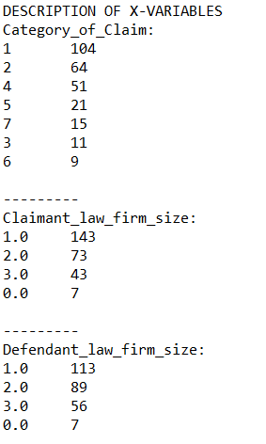
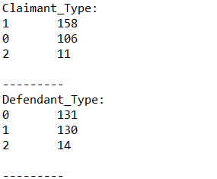
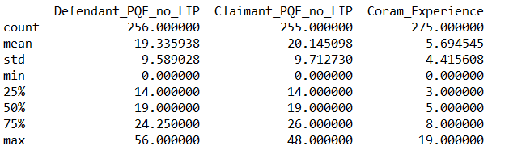
Descriptive Analysis of X-Variables
Total Number of Data Points: 275
Claimant PQE and Defendant PQE have lower counts:
Litigants-in-person were removed
Some data was missing from the sources.

Slide 20
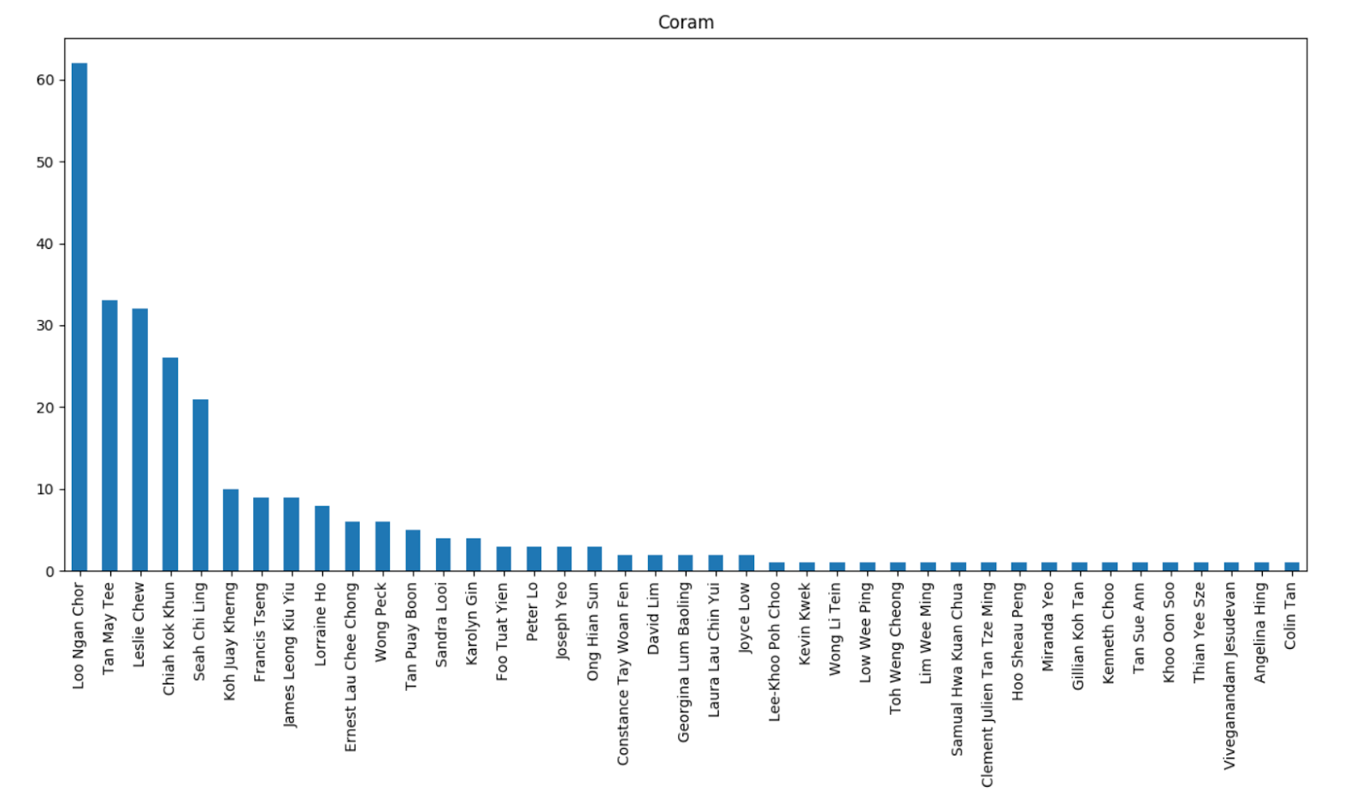
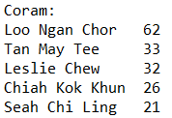
Frequent Judges
Top 4 Judges account for more than half the total reported cases.
More than half the Judges have 2 or less reported judgements.

Slide 21
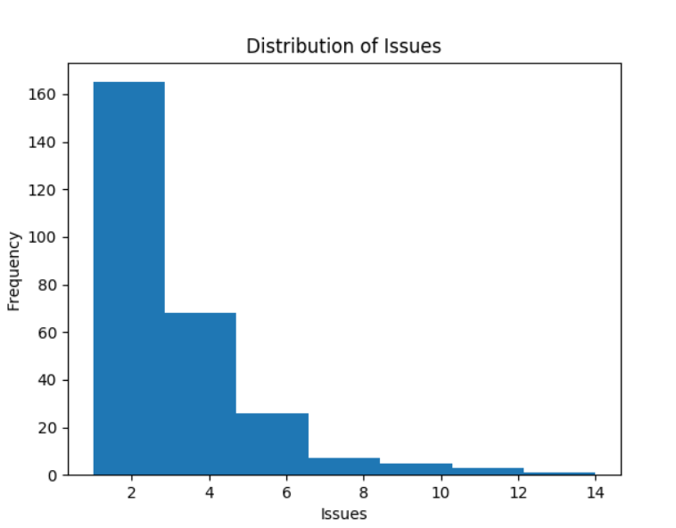
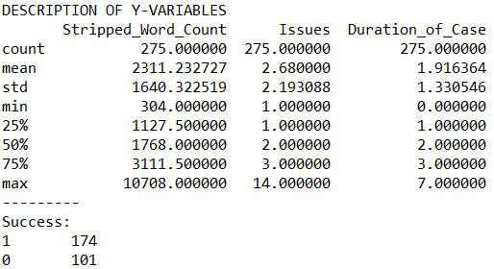
Descriptive Analysis of Y-Variables
Most cases have 2 – 4 issues.

Slide 22
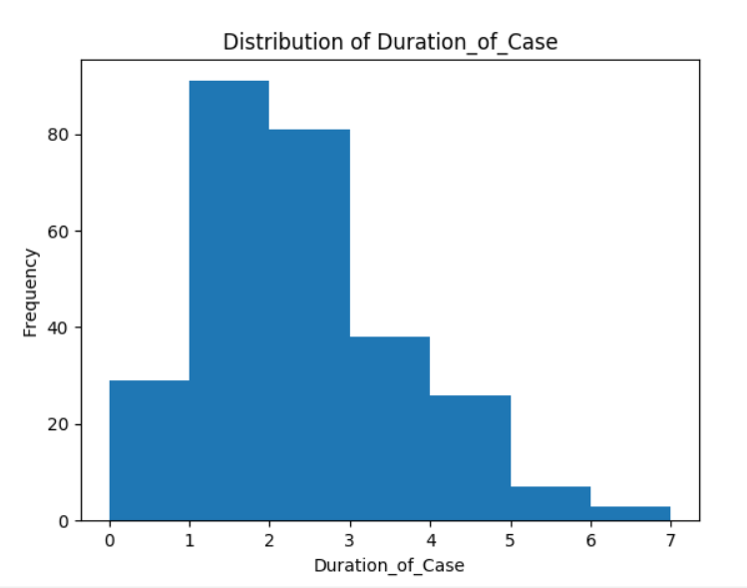
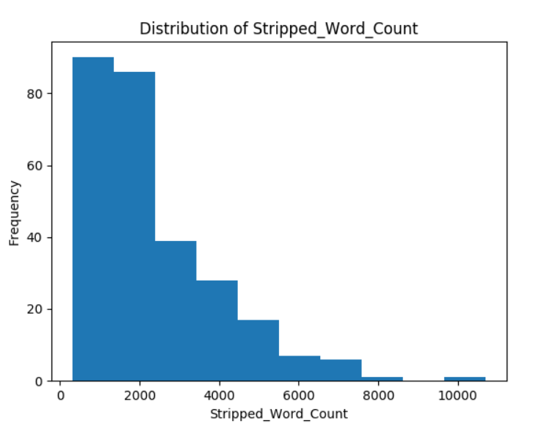
Descriptive Analysis of Y-Variables
Most cases take up to 1-3 years.
Most judgments are below 3000 words.

Slide 23
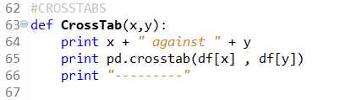
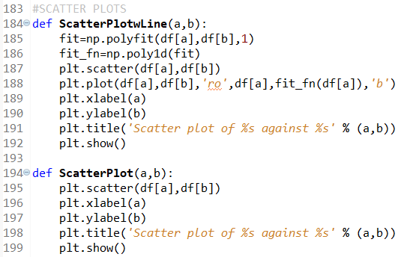
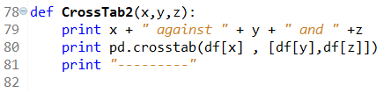
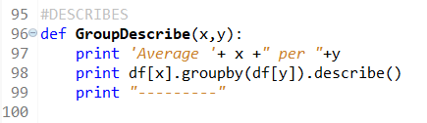
Describing Descriptive Code
CrossTabs
ScatterPlot
Cross Tabulation table of 2 categorical variables
Graphical representation of distribution of data points with respect to two variables
Cross tabulation table of 3 categorical variables
(ScatterPlotwLine used when suitable.)
GroupDescribe
Describes quantitative variables grouped according to a categorical variable.

Slide 24
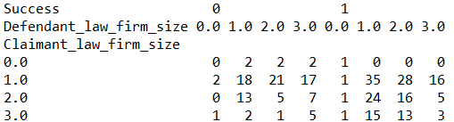
Curious CrossTabs
overall ratio of successes to failures: 1.7
Litigants-in-person are not successful against law firms.
Medium Sized firms:
successful against firms the same size or smaller
significantly less successful against larger firms.
Small Sized Firms:
raw number of successes for small firms > losses in the same matchups,
BUT ratio < overall ratio of successes to failures
Small firm-Small firm matchup: success ratio (1.94) > overall ratio.
Small firms are thus less successful against larger firms.
Big firms:
significantly less successful against other big firms.

Slide 25
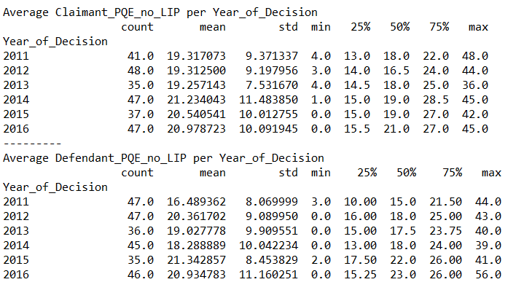
Interesting Describes
Average PQE from 2011 to 2013 [19.293 ; 18.625]
lower than from 2014 to 2016 [20.917 ; 20.188] for both Claimants and Defendants

Slide 26
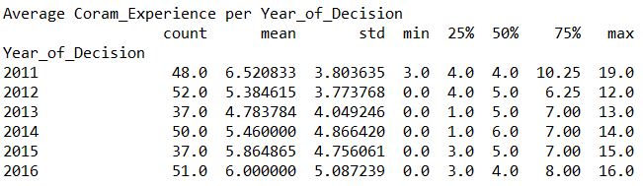
Interesting Describes
Average Coram Experience is relatively stable between the same periods [5.562 ; 5.774].
Possible Inference: The same lawyers are taking the State Court cases, whereas the roster of judges is constantly changing.

Slide 27
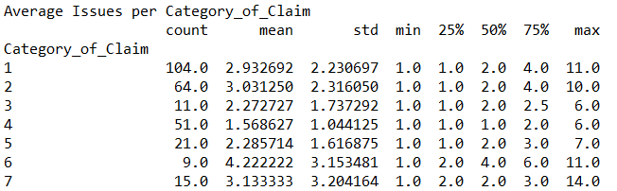
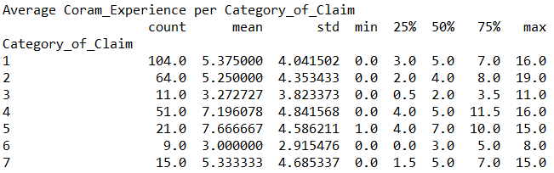
Interesting Describes
Property/Equity Cases have lesser issues,
and are dealt with by more junior Judges.
Civil Procedure Cases have the lowest mean number of Issues,
but are dealt with the second most senior groups of judges.

Slide 28
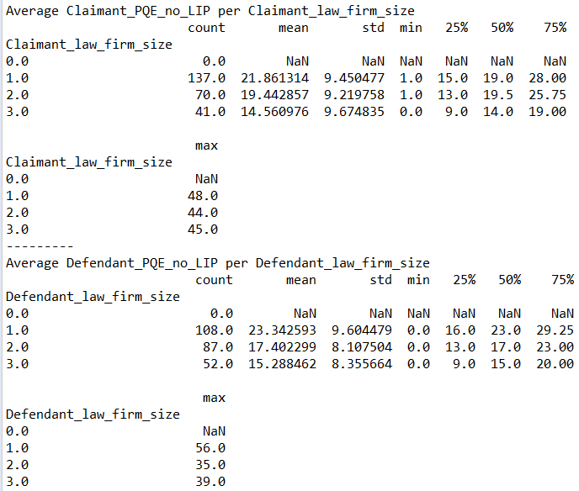
Interesting Describes
mean PQE of lawyers from large firms significantly lower than those from small (6 year gap) and medium sized firms (2.5 years gap)
Data suggests that the bigger the firm, the sooner a relatively junior lawyer will be the first chair on the case.

Slide 29
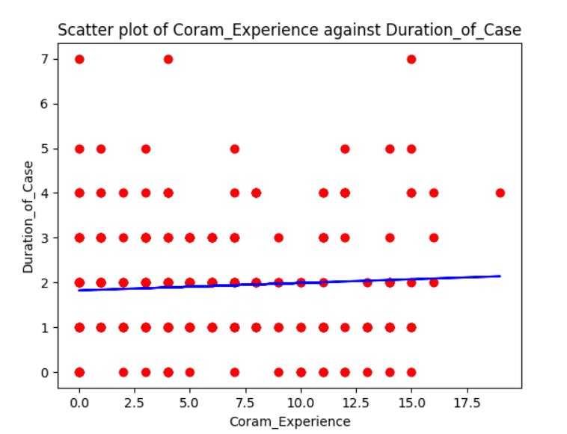
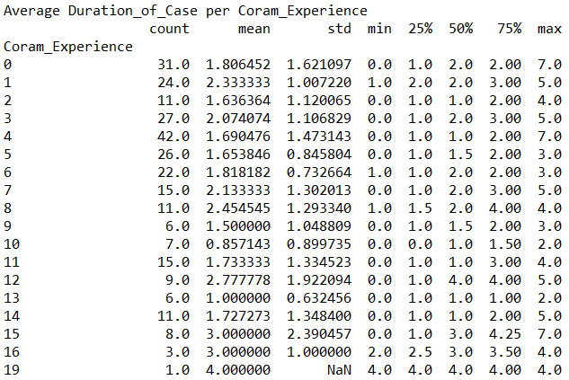
Interesting Describes
Initial Hypothesis:
More experienced judges would get assigned more difficult cases
Expected correlation between judge’s experience and time taken to complete the case.
However, the near horizontal linear regression line suggests:
judge’s experience has nearly no effect on time taken
positive gradient suggests time taken also does not decrease with more experience - more experience =/= faster.

Slide 30
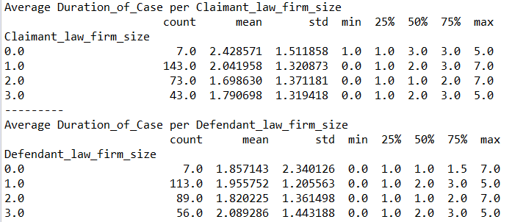
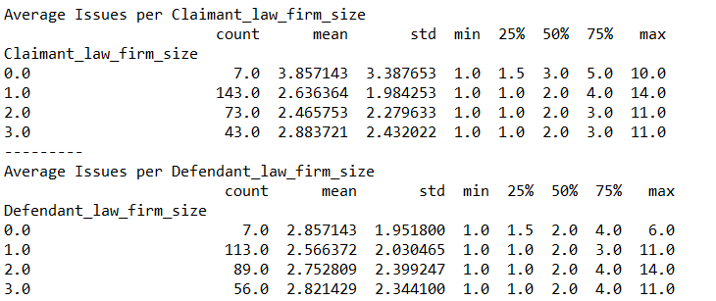
Interesting Describes
Claimants who bring their own claims as litigants-in-person raise more issues than lawyers.
Their claims also take longer to complete.
However, this does not hold true for defendants who defend themselves as litigants-in-person.

Slide 31
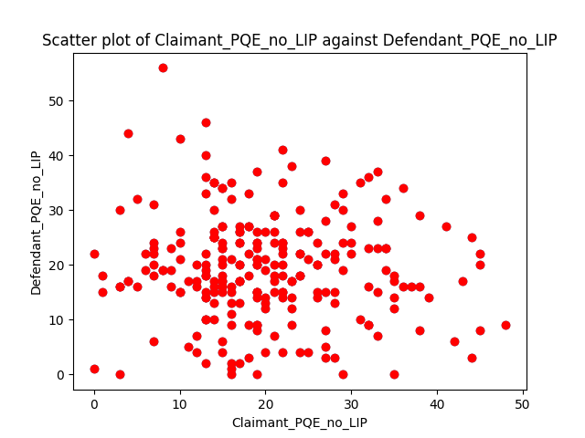
Selected ScatterPlots
Number of data points in the green triangle > number in the blue triangle
likely that Claimant lawyers are more experienced than Defendant lawyers in any given case.

Slide 32
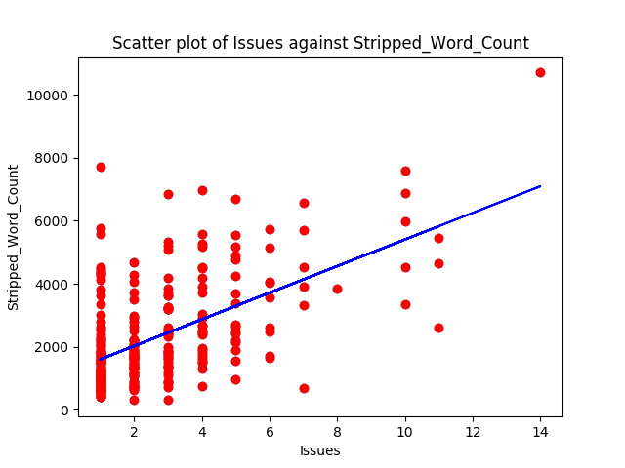
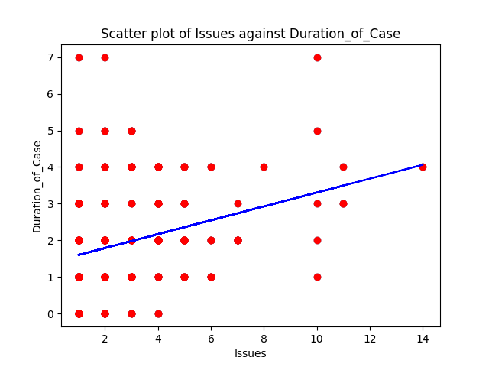
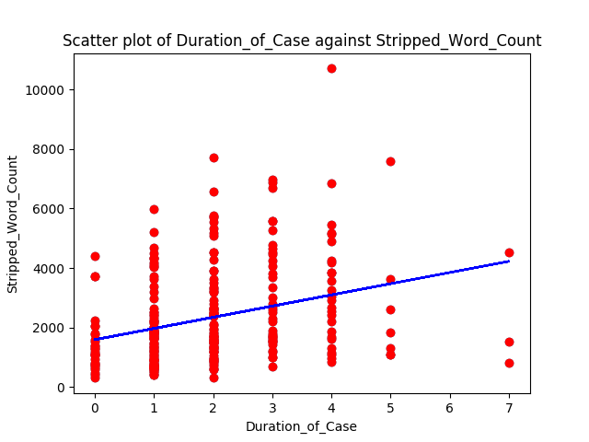
Selected ScatterPlots
All our quantitative Y variables have positive correlations!
Suggests general efficiency of the State Courts as duration of case ties in with complexity of case generally.

Slide 33

Statistical Analysis of Collected Data

Slide 34
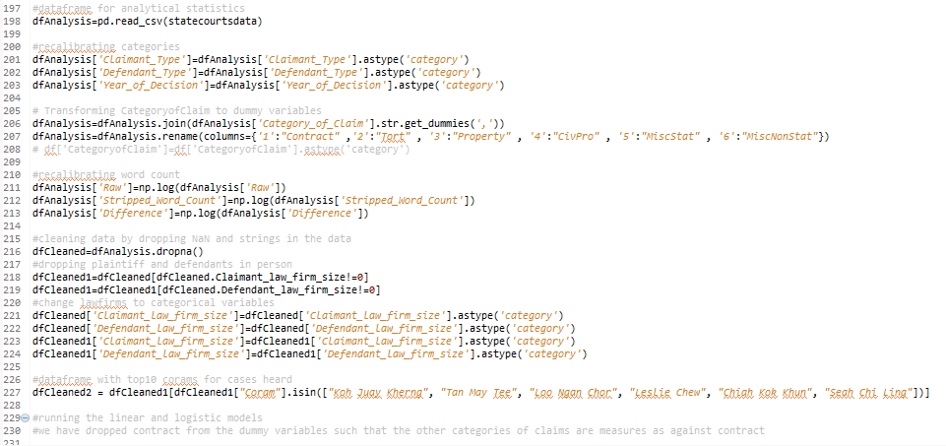
Recalibrating our Data

Slide 35
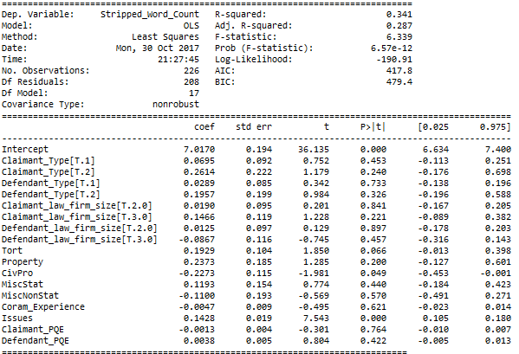
Linear Regression Model 1
Stripped word count: the number of keywords the judge used, deducting numbers, punctuation and stopwords
Stripped Word Count (Y) Against Different Non-legal factors (X)
Purpose: to see whether the different non-legal factors would have a significance on proxy of work done by the judge
R² = 0.341, not the best but not too dissatisfactory
Size of claimant and defendant law firm, and claimant and defendant PQE do not seem to be significant.
Number of issues and Duration of Case significant

Slide 36
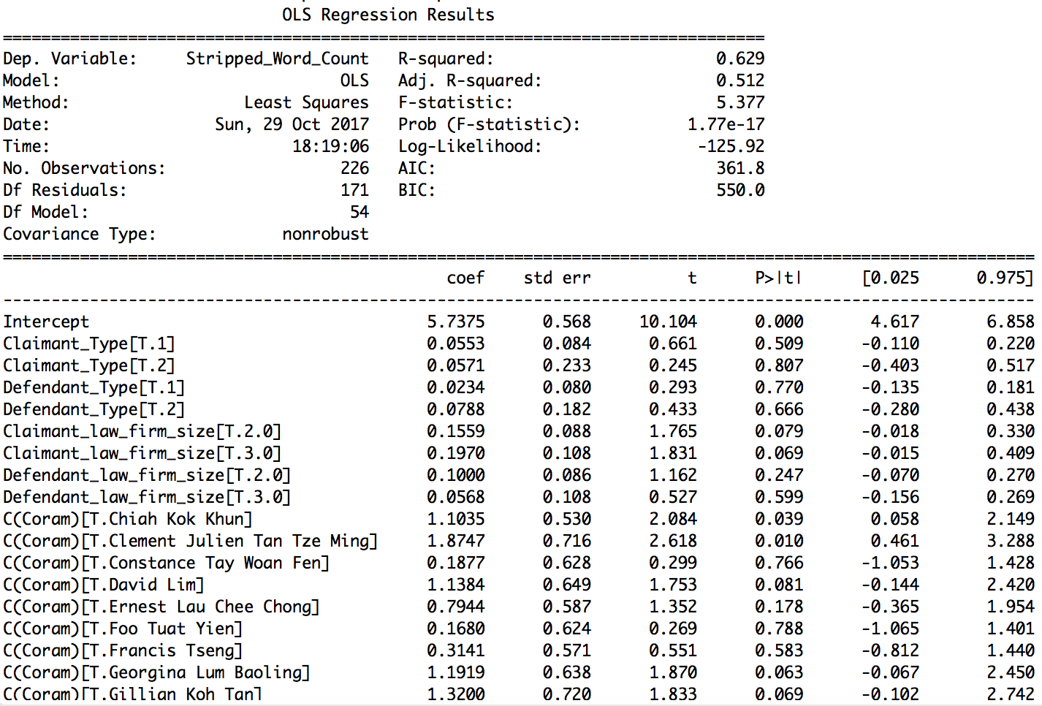
Linear Regression Model 2 – Best Model
Obtained by re-calibrating the unique Coram names as categorical variables
Best R² = 0.629 adjusted R² = 0.512
However, possibly an overfitted model

Slide 37
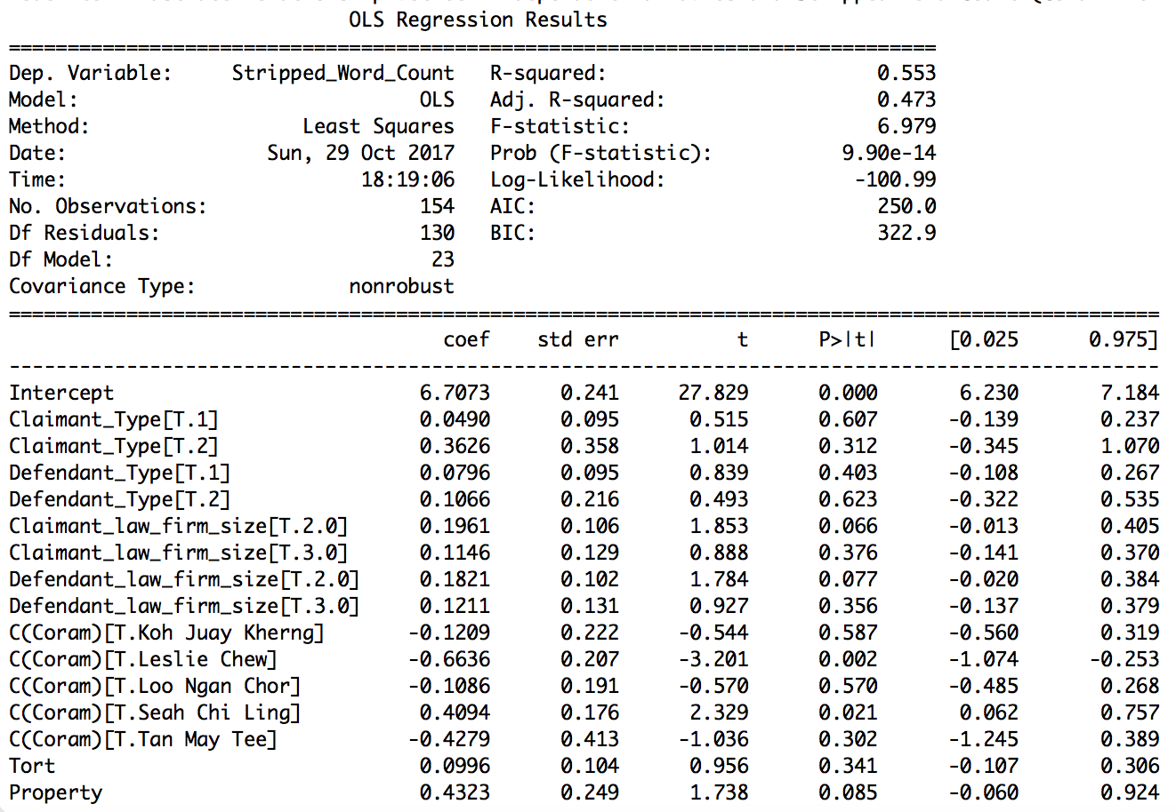
Linear Regression Model 3 – 2nd Best Model
Similar as Linear Model 2 but Used only Corams with 10 or more cases heard, so model can properly plot normal distribution curve for Corams
2nd Best R² = 0.553 adjusted R² = 0.473
Trade off → Fewer observations
Taking Chiah Kok Khun (with 0 coram experience) as base, statistically significant that:
Leslie Chew writes shorter judgements than him
Seah Chi Ling writes longer judgements than him

Slide 38
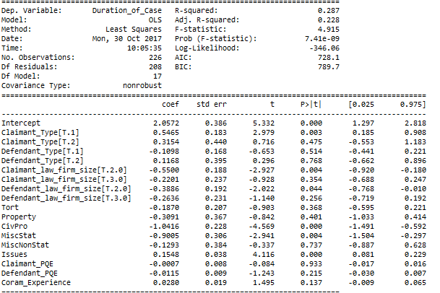


Linear Regression Model 4
Duration of Case (Y) Against Different Non-legal factors (X)
R2 value = 0.288, not very significant
More significant p values
Conclusions drawn:
1. More issues, longer the resolution time for the case
2. As compared to a small firm, the bigger firms have faster resolution times for both claimants and defendants
(although pvalue not very significant for big firms)

Slide 39
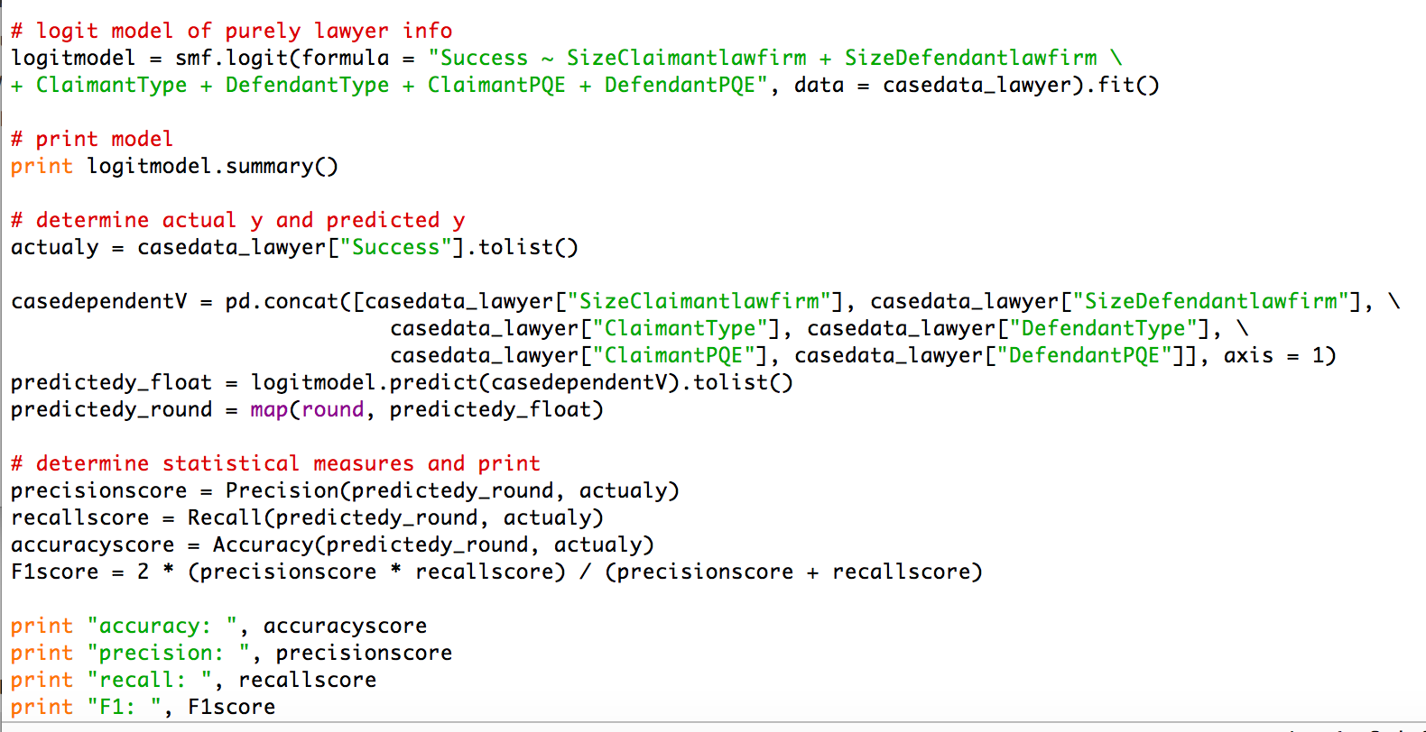
Evaluating Strength of Logistic Regression Model
F1 score is the weighted average of Precision and Recall.

Slide 40
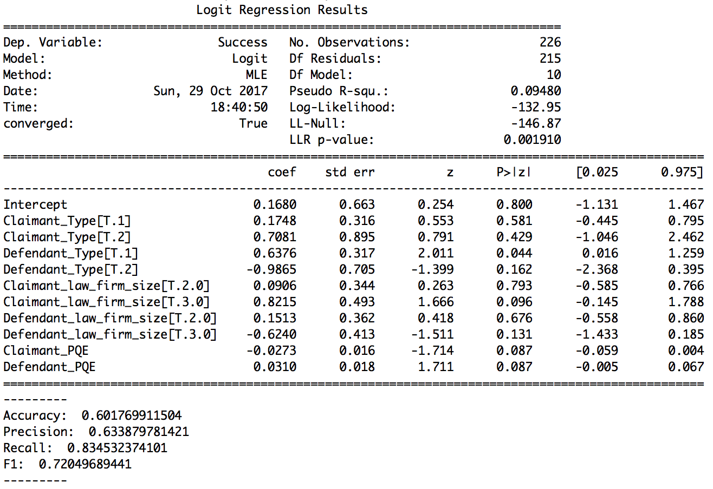
Logistic Regression Model
Legend:
1 → Small
2 → Medium
3 → Large
Success of Claim (Y) Against Different Non-legal factors (X) – excluding LIPs
Decent Accuracy and Precision score
GoodRecall score: 0.834
Good F1 score: 0.720
However, overall intercept has high p value → No statistically significant relationship between all the non-legal factors of the case on success of plaintiff

Slide 41
Logistic Regression Model
Legend:
1 → Small
2 → Medium
3 → Large
Type of Claimant (as against Company)
High p values → No statistically significant relationship between ClaimantType and Claimant's success
Type of Defendant (as against Company):
Df = Individual: Very low p value and positive coefficient → when against Df who is an individual, Claimant has higher odds of success compared to when Df is a company

Slide 42
Logistic Regression Model
Legend:
1 → Small
2 → Medium
3 → Large
Size of Claimant law firm
Relatively low p value and positive coefficient→ Probable that Claimant has higher odds of success hiring a large over a small law firm
Size of Df law firm
Relatively low p value and negative coefficient → Probable that Claimant, up against Df represented by a Large firm, has lower odds of success, compared to if Df is represented by small firm

Slide 43
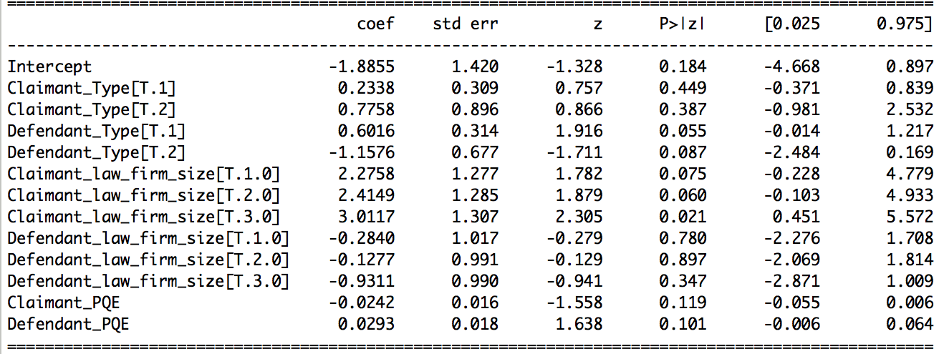
Logistic Regression Model
Legend:
0 → LIP
1 → Small
2 → Medium
3 → Large
Success of Claim (Y) Against Different Non-legal factors (X) – INCLUDING LIPs
Size of Claimant law firm (as against LIP)
Clmt = Large/ Medium/ Small: Low p value and positive coefficient → Statistically significant that Claimant has higher odds of success if represented by a law firm
Df = Large/ Medium/ Small: High p values → Cannot confirm a relationship

Slide 44



Evaluation
Limitations of Data Set
Limited Scope
Only did civil cases in 2011 -2016
Possibility of Extension:
i) Other Time Periods
ii) Family and Criminal Law Cases
i) Extremely long cases
ii) Two cases with same PF and DF but different citation
iii) Case where unclear if litigants were represented
Missing or Anomalous Data Points
Standardization Issues
Differences in Interpretation for Number of Issues

Slide 45





Evaluation
Fitness of Model
Possible Variables for Extension
Overall decent R-squared
Clearance Rates
Model with highest R-squared value may be over-fitted
Not all variables were statistically significant
Age of active pending caseload
Good thing that non-legal variables we looked at had overall little bearing on the success and efficiency of a case
Average cost of processing case

